Slide 1
Useful Resource
W3Schools:
https://www.w3schools.com/sql/sql_ref_keywords.asp

Slide 2
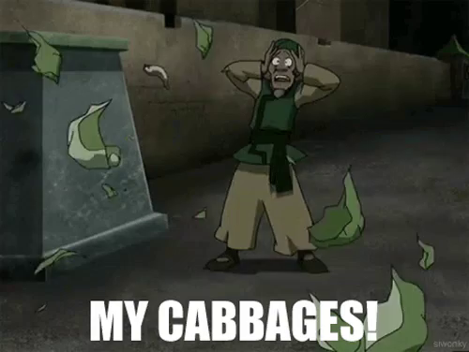
Practice: Cabbages
Credits to Josh Archibald

Slide 3

Practice: Cabbages

Slide 4
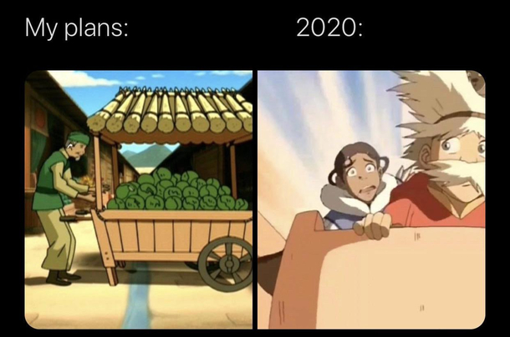
Practice: Cabbages

Slide 5
Practice: Cabbages
1. Create a database.
Create a database called cabbages.db.
touch cabbages.db

Slide 6
Practice: Cabbages
2. Open the database in SQLite.
sqlite3 cabbages.db

Slide 7
Practice: Cabbages
3. Create some tables.
Let's get this database started! Cabbage Man is hoping to have 3 tables to get off the ground:
customers
id (INTEGER, PRIMARY KEY)
name (TEXT, NOT NULL)
email (TEXT, NOT NULL)
invoices
id (INTEGER, PRIMARY KEY)
customer_id (INTEGER, NOT NULL)
total_value (REAL, NOT NULL)
cabbages
id (INTEGER, PRIMARY KEY)
cabbage_type (TEXT, NOT NULL)
batch_id (INTEGER, NOT NULL)
invoice_id (INTEGER, NOT NULL)
value (REAL, NOT NULL)

Slide 8
Practice: Cabbages
4. Inserting some data into the database.
We will practice INSERT by adding some customers
Name | Email
Aang | aang@team.avatar
Iroh | iroh@fire.gov
Katara | katara@team.avatar
Sokka | sokka@team.avatar
Toph | toph@team.avatar
Zuko | zuko@fire.gov

Slide 9
Practice: Cabbages
5a. Simulate some cabbage purchases.
Download simulate.py from this folder: https://drive.google.com/drive/folders/1Zn1dIEn4mKi6fOxVMIb15yA_XHk1kcHU?usp=sharing
Upload it to your IDE and run it (python simulate.py) to add more customers, cabbages, and invoices to your tables!

Slide 10
Practice: Cabbages
5b. Switch to SQL files for the rest of this.
We're going to be writing some longer SQL statements for the rest of this exercise, so best to go ahead and create some SQL files so you can edit them and change them incrementally. (Writing longer code in the SQLite program is possible, just tedious.)
touch ozai.sql red.sql recall.sql

Slide 11
Practice: Cabbages
6. The world can't know Ozai likes cabbage. Write in ozai.sql for this part.
The Fire Lord (Ozai) loves cabbage, but he doesn't want there to be any traces of his latest purchases from the cabbage merchant. We have a couple tasks here:
Update any invoices involving the Fire Lord to point to another customer, so any audits won't look suspicious.
Delete Ozai's entry (row) in the customers table.

Slide 12
Practice: Cabbages
6. The world can't know Ozai likes cabbage. Write in ozai.sql for this part.
The Fire Lord (Ozai) loves cabbage, but he doesn't want there to be any traces of his latest purchases from the cabbage merchant. We have a couple tasks here:
Update any invoices involving the Fire Lord to point to another customer, so any audits won't look suspicious.
Update any invoices involving the Fire Lord to have Uncle Iroh listed as the customer instead.
Pseudocode: UPDATE invoices SET customer_id = (customer ID of Iroh) WHERE customer_id = (customer ID of Ozai);
Test that you’ve done this correctly by running:
SELECT id FROM invoices WHERE id = (SELECT id FROM customers WHERE name = "Ozai");
What should you see (or not see) as the output?

Slide 13
Practice: Cabbages
6. The world can't know Ozai likes cabbage. Write in ozai.sql for this part.
The Fire Lord (Ozai) loves cabbage, but he doesn't want there to be any traces of his latest purchases from the cabbage merchant. We have a couple tasks here:
Update any invoices involving the Fire Lord to point to another customer, so any audits won't look suspicious.
Update any invoices involving the Fire Lord to have Uncle Iroh listed as the customer instead.
UPDATE invoices SET customer_id = (customer ID of Iroh) WHERE customer_id = (customer ID of Ozai);
Delete Ozai's entry (row) in the customers table.
Verify that you’ve done this correctly by running:
SELECT id FROM customers WHERE name = "Ozai";
Again, what you should see/not see?

Slide 14
Practice: Cabbages
7. The cabbage man wants to keep track of customers who have ordered Red cabbages. Write in red.sql for this part.
Write a SQL query that uses JOIN to list out each customer id and the number of Red cabbages they ordered.
Pseudocode:
SELECT (customer ids), (number of invoices for that customer)
FROM invoices JOIN cabbages ON (id of invoice) = (cabbages with that invoice id)
WHERE (cabbage type is “Red”) GROUP BY (customer ids)

Slide 15
Practice: Cabbages
8. Recall. Use recall.sql to write your answers for this part.
Oh no! Cabbage number 433 has been found to be defective, and we have to recall the entire batch. Ultimately, we want to know 1) how many cabbages were affected, 2) their average (and total) value, and 3) get the names and emails of the customers we should contact about the problem.

Slide 16
Practice: Cabbages
8. Recall. Use recall.sql to write your answers for this part.
Oh no! Cabbage number 433 has been found to be defective, and we have to recall the entire batch. Ultimately, we want to know 1) how many cabbages were affected, 2) their average (and total) value, and 3) get the names and emails of the customers we should contact about the problem.
Pseudocode:
SELECT COUNT(id)
FROM cabbages
WHERE batch_id = (batch ID of cabbage 433);

Slide 17
Practice: Cabbages
8. Recall. Use recall.sql to write your answers for this part.
Oh no! Cabbage number 433 has been found to be defective, and we have to recall the entire batch. Ultimately, we want to know 1) how many cabbages were affected, 2) their average (and total) value, and 3) get the names and emails of the customers we should contact about the problem.
Hint: Try using the AVG and SUM functions

Slide 18
Practice: Cabbages
8. Recall. Use recall.sql to write your answers for this part.
Oh no! Cabbage number 433 has been found to be defective, and we have to recall the entire batch. Ultimately, we want to know 1) how many cabbages were affected, 2) their average (and total) value, and 3) get the names and emails of the customers we should contact about the problem.
Steps:
Get invoice_id of every cabbage in the batch that was sold
Get all distinct customer_id associated with each invoice that may have a bad cabbage (Hint: use DISTINCT function and IN instead of =)
Get name, email of each customer with that customer_id, order alphabetically by name (Hint: use ORDER BY and IN)

Slide 19
Practice: Cabbages
9. Create invoices!
Write a program invoices.py that allows a user to create invoices by inputting their name, email, and total_value of the purchase. In order to create a valid invoice, the following conditions must be satisfied:
The name must be valid (in the customers table)
The email must be valid (in the customers table)
The total_value must be > 0
Print out a success message after inserting

